Slide 1
Program Development
CptS 360 Systems Programming
School of Electrical Engineering and Computer Science
Washington State University
Hassan Ghasemzadeh (hassan.ghasemzadeh@wsu.edu)

Slide 2
Topics
The focus of this part of the class is on program development
This is basically Chapter 2 of the systems programming textbook
Topics that are discussed include
Text editors
Steps in program development
Function calls in C
Link C program with assembly code
The GDB debugger
Structures in C
Link list, Trees, binary trees, binary search trees

Slide 3
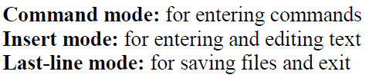
Text editors in Unix/Linux
A number of text editors are available Unix
Examples are
Vim & vi
Nano
Gedit
Emacs
Vim
‘vim’ is the standard built-in text editor for Linux
It is however a bit less convenient because it uses three modes for different operations

Slide 4
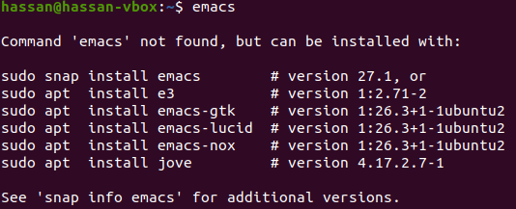
Text editors
Read about different editors in textbook and pick one to use in this class
‘emacs’ is a popular and user-friendly editor
How to run emacs editor?
From the command line, enter the following command
$ emacs [FILENAME]
FILENAME is optional
Emacs is not installed on Ubuntu by default

Slide 5
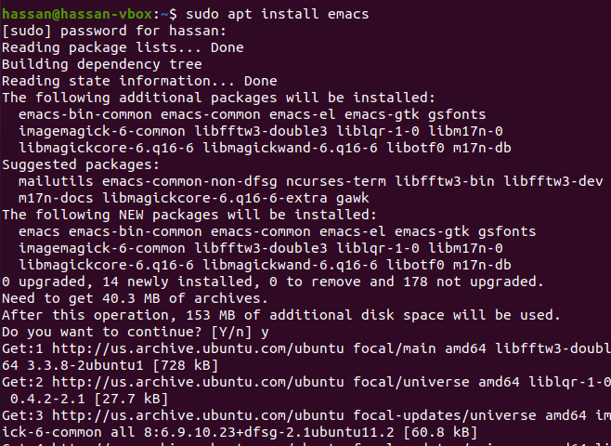
Installing emacs editor
Use the command ‘sudo apt install emacs’
After installing emacs, you will be able to use menus on top to create a new file, write code, edit, compile, debug, etc.

Slide 6
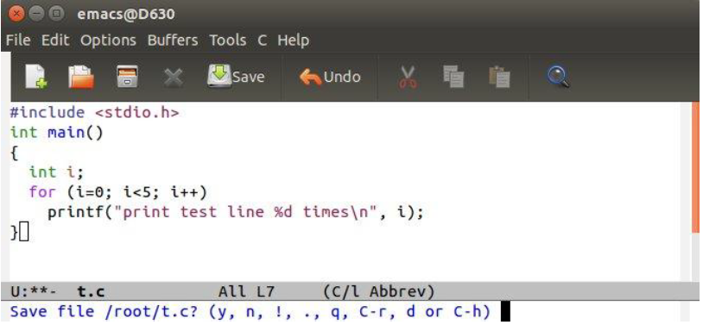
Emacs menus
File: open file, insert file, save files, printing the editing buffer, open new windows and new frames.
Edit: search, replace,
Options: configure emacs operations
Buffers: selection and display of buffers
Tools: compile source code, execute binary executables, debug
C: customized editing for C source code
Emacs provides an Integrated Development Environment (IDE) for software development: compile C programs, run executable images and debugging program executions

Slide 7
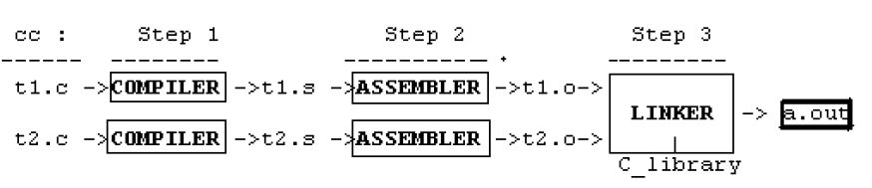
Steps for program development
Generally, there are two major steps
(1) Use an editor to create your C source file
(2) Use gcc to convert your code to executable binary
For example, command “$ gcc t1.c t2.c” will create an executable file “a.out”
Assuming that there is no compilation error
Steps during compilation
We are going to go over details of this process through an example

Slide 8
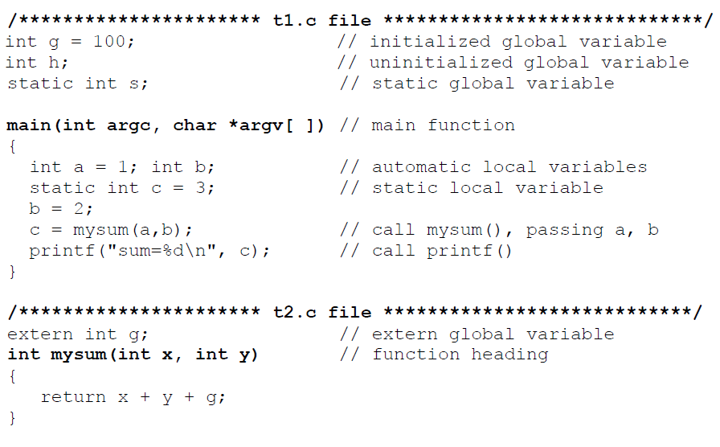
Creating source files (example)
Assume we have created these two source files ‘t1.c’ and ‘t2.c’
What does each variable type mean?
Where is each variable accessible?

Slide 9
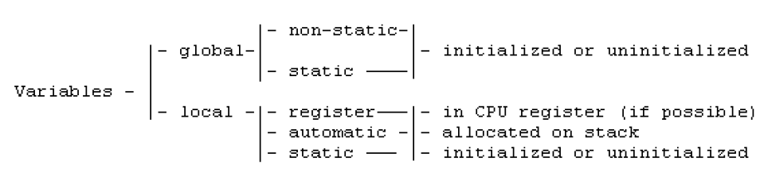
Variables in C
Global variables are defined outside of any function. They are unique and have only one copy. By default, global variables are non-static.
Static global variables are visible only to the file in which they are defined.
Non-static global variables are visible to all the files of the same program.
Initialized global variables are assigned values at compile time.
Uninitialized global variables are initially cleared to 0

Slide 10
Variables in C
Local variables are defined inside functions. They are visible only to the function in which they are defined.
Compiler allocate register variables in CPU registers.
By default, local variables are automatic: they come into existence when the function is entered and they disappear on exit
No allocated memory space until the function is entered
Cannot be initialized at compile time (no memory allocated at compile time)
Static local variables are permanent and unique: can be initialized
Does this mean initializing ‘a’?
No, because ‘a’ does not yet exist at compile time

Slide 11
Compilation steps
Step 1. Compiler converts C source files to assembly code files
Step 2. Assembler converts assembly Code to object code.
Step 3. Linker combines all object files and needed library functions into a single binary executable file
What C libraries will be included in the binary executable file (a.out)?

Slide 12
Static & dynamic linking
There are two types of linking (static and dynamic)
Default linking approach is dynamic linking
Static linking
Uses a static library
Linker includes all needed library function codes and data into a.out.
The output file a.out is self-contained but very large in size
Dynamic linking
Uses a shared library
C library functions are not included in a.out
Calls to needed library functions are recorded in a.out
Operating system loads both a.out and the shared library into memory during execution
Which linking approach is more efficient? Why?
Notes:
Advantages of dynamic linking:
(1) Size of a.out is small
(2) Executing programs may share the same library functions in memory
(3) Modifying library functions does not need to re-compile the source files again.

Slide 13
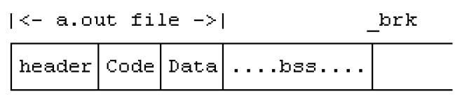
Content of ‘a.out’ file
An a.out file looks like
It consists of the following fields:
Header contains loading information and sizes of the a.out file
tsize = size of Code section
dsize = size of Data section containing initialized globals and static locals
bsize = size of bss section containing uninitialized globals and static locals
total_size = total size of a.out to load.

Slide 14
Content of ‘a.out’
Other fields in a.out
CODE section (or text section) contains executable code of the program. It begins with the standard C startup code crt0.o, which calls main().
DATA section contains initialized global and static variables
BSS section
BSS section, which contains uninitialized global and static local variables, is not in the a.out file.
Its size is recorded in a.out header though (i.e., bsize)
Automatic local variables are not in a.out
Where are they assigned in memory then?

Slide 15
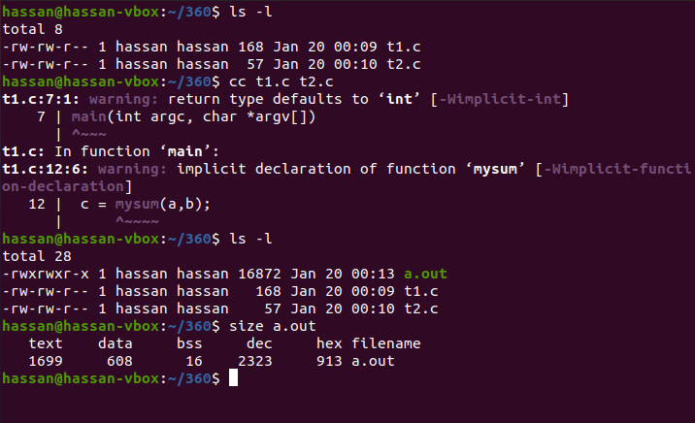
Examining size of a.out
Consider our running example!

Slide 16

Example (continued)
What happens if we change variable ‘h’ to an array of size ’10’?
Previously we had “int h;”
And this was the output of ‘size a.out’ command:
Now we have “int h[10];”
What section size will change?

Slide 17
Function calls in C
Motivation
Examine run-time behavior of a.out
Run-time behavior
Stems mainly from function calls
crt0.o calls main(), and main() calls other functions, etc.
Our focus
Running C programs on 32-bit Intel processors
Parameters are passed on the stack during function calls
CPU register ebp points to stack frame of the current executing function
We refer to this pointer as Frame Pointer (FP)

Slide 18
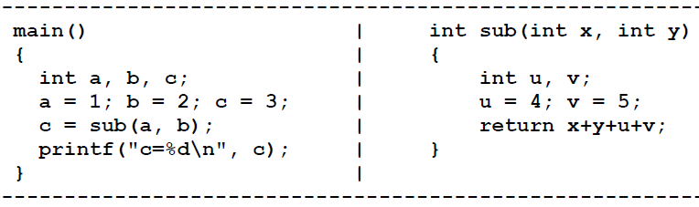
Process image
Consider the following example with two functions main() and sub()
Process image in memory looks like
Data section includes both initialized data and bss in this execution image
Heap is the space used for dynamic memory allocation

Slide 19
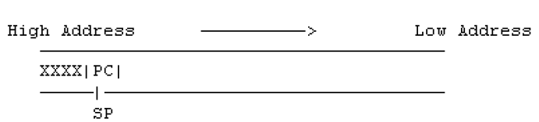
Stack content upon function call
Processor registers
PC (IP): points to next instruction to be executed
SP (SP): points to top of stack
FP (BP): points to the stack frame of current active function
Return Value Register (AX): register for function return value
Stack upon calling main()
XXXX means stack contents before crt0.o calls main()
SP points to the saved return PC
main() is called by startup code crt0.o
When crt0.o calls main()
it pushes the return address onto stack
It replaces PC with the entry address of main()
Therefore, CPU enters main() next

Slide 20
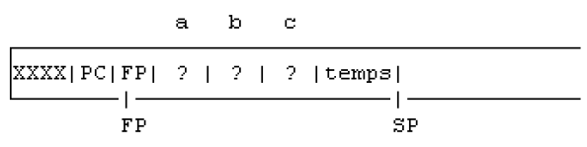
Stack upon entering the function
Upon entering a function
Push FP onto stack (save CPU's FP on stack)
Update FP to point at the saved FP (establish stack frame)
Shift SP downward to allocate space for automatic local variables
Shift SP farther down to allocate temporary space
Stack upon entering main()

Slide 21
Stack during execution of the function
Executing a=1; b=2; and c=3; places values 1, 2, 3 into the memory locations of a, b, c, respectively.
1
2
3
How does CPU access these variables?
Assume size of (int) is 4 bytes
Variables a, b, c are at -4, -8, -12 bytes from where FP points at
Expressed as -4(FP), -8(FP), -12(FP) in assembly
For example, the assembly code for b=2 is
movl $2, -8(%ebp)
$2 means value 2
%ebp refers to the ebp register

Slide 22
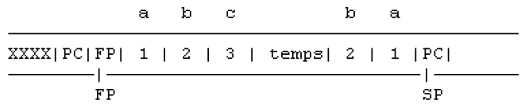
Nested function calls
main() calls sub() by c = sub(a, b)
The compiled code of the function call consists of
Push parameters in reverse order, i.e. push values of b=2 and a=1 into stack
Call sub()
Pushes the current PC onto stack
Replaces PC with the entry address of sub()
Causes the CPU to enter sub() next
stack content upon calling sub()
Note: when control enters sub(), stack contains a return address (PC) at the top, preceded by the parameters, a, b, of the caller

Slide 23
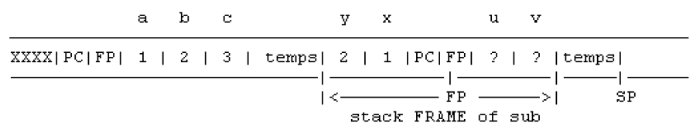
Evolution of stack
The stack content gets updated upon entering sub()
Stack upon entering sub()
The process is similar to the one for entering main()
The stack gets updated as CPU executes sub()
4
5

Slide 24
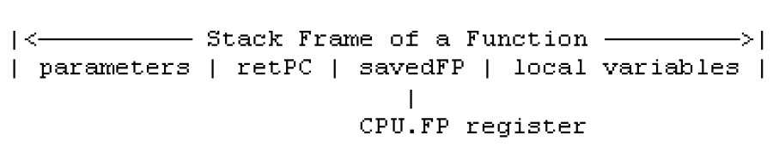
Stack frames
Stack frame
The stack area visible to a function
What should be visible to a function such as sub()?
global variables
parameters passed in by the caller
local variables
Global and static local variables are in Data section
They are not in stack
They can be access differently
How does compiler references parameters and local automatic variables?
using stack frame pointer (FP)

Slide 25
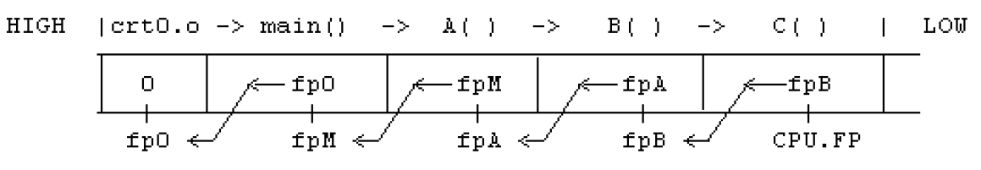
Frame pointer in nested calls
How do frame pointers look like in nested calls?
It looks like a linked list as shown above
Frame at the stack top is stack frame of current executing function, which is pointed by the CPU's frame pointer
FP is initially 0 when crt0.o is entered from the OS kernel
As CPU returns from functions, stack frames are deallocated, and the stack shrinks back
What happens during return from functions?

Slide 26

Return from function
What happens upon return?
Function (e.g., sub())
Return value (e.g., x+y+u+v) is calculated and placed into return value register (AX)
Copy FP into SP (SP now points to saved FP in stack)
Pop stack into FP (restores FP, which now points to the caller's stack frame (leaves return PC on stack top)
Execute RET instruction (pops stack top into PC)
x+y+u+v
AX reg.
PC
FP
SP
SP
SP
4
5

Slide 27
Return from function
Caller (e.g., main())
Catches the return value in the return register (AX)
Cleans parameters a, b, from the stack (by adding 8 to SP)
This restores the stack to the original situation before the function call.
Continues to execute the next instruction.
FP
SP
4
5
1
2
3
27

